Slide 1
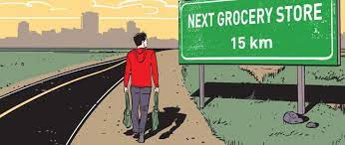
Food Deserts in Northern California
Payson Cushman, Vandrea Foronda, Mina Kemmer-Lee

Slide 2


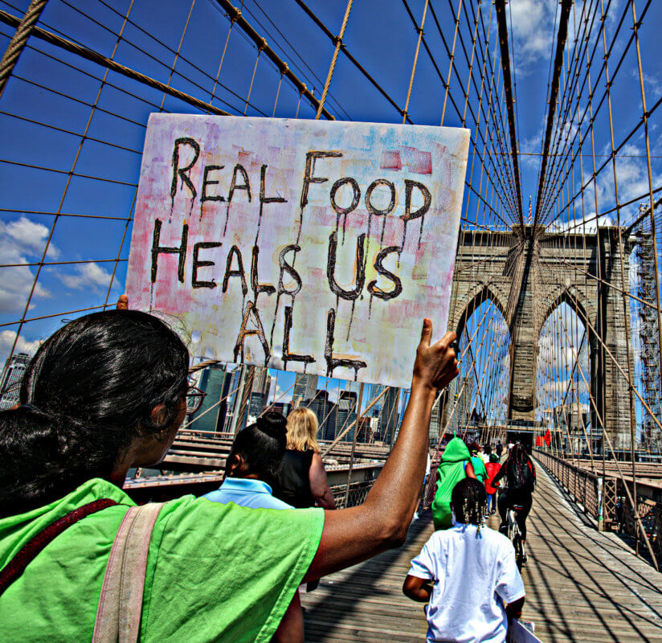
What are food deserts?
Limited access to supermarkets, grocery stores or other
sources of healthy & affordable food

Slide 3
What are food deserts?
Indicators include:
Distance to a store or number of stores in an area
Individual resources that affect accessibility (vehicle availability)
Average income of neighborhood & public transportation availability

Slide 4
Does socioeconomics and demographics play a role
in the amount of food deserts in a county?
How common are food deserts?
Does population & household income affect access?
Are there higher rates of health problems where there are food deserts?
Are there more of a certain restaurant type in areas of food deserts?

Slide 5
Do socioeconomics and demographics play a role
in the amount of food deserts in a county?
Resources
Food Access Research Atlas
US Census Data
Geoapify API

Slide 6
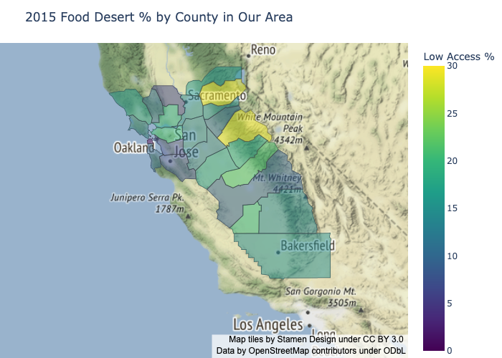

2015 Food Desert % By County in Northern California
Low Access %

Slide 7
2015 Food Desert % By County in Northern California
Low Access %

Slide 8
2015 Food Desert % By County in Northern California
Low Access %

Slide 9
2015 Food Desert % By County in Northern California
Low Access %

Slide 10
2015 Food Desert % By County in Northern California
Low Access %

Slide 11
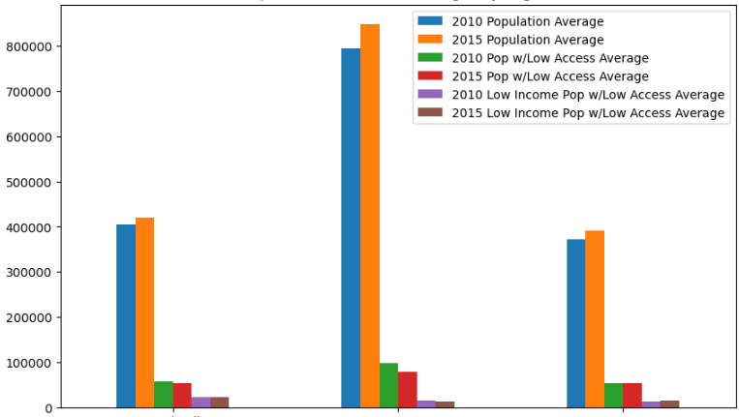
Population and Access Averages by Region
Population with Low Access Average
Central Valley
Bay Area
Sacramento

Slide 12
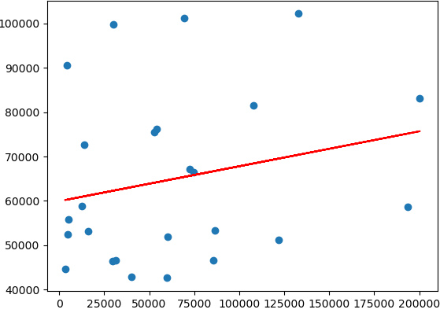
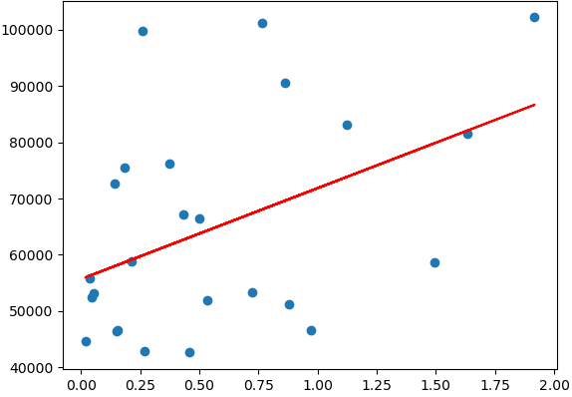
Household Income (2015)
Population with Low Access vs Avg Household Income
Population vs Avg Household Income
Avg Household Income
Avg Household Income
Population with Low Access
Population
r = 0.051
r = 0.198

Slide 13
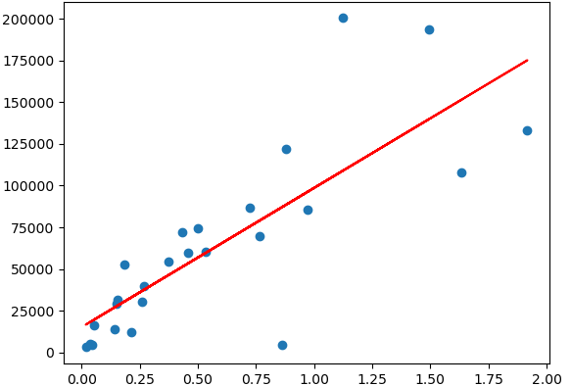
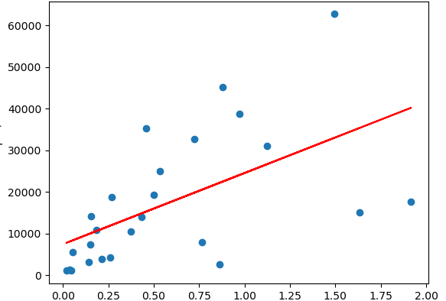
Low Store Access (2015)
Population vs Low Store Access
Population vs Low Income Low Store Access
Low Store Access
Low Income Low Store Access
Population
Population
r = 0.644
r = 0.3218

Slide 14
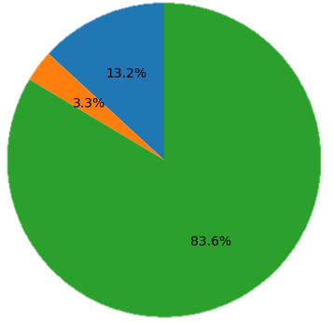
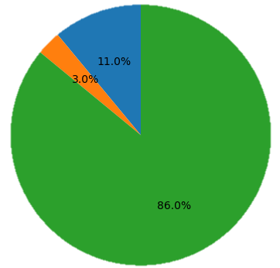
Total Population by Access & Low Income Low Access
2010
2015
Low Access Population
Low Income & Low Access Population
Other Population

Slide 15
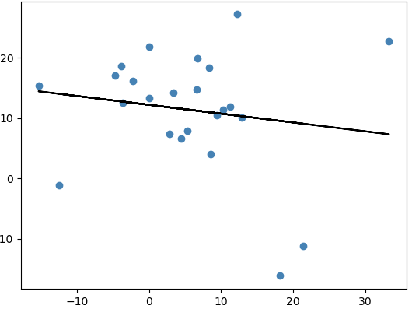
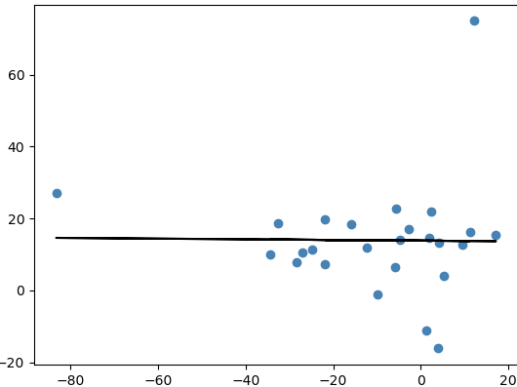
Fast Food Availability in Low Access Areas
Change in Grocery vs Change in Fast Food
Change in Low Access vs Change in Fast Food
Change in Fast Food
Change in Fast Food
Change in Grocery Stores
Change in Low Access
Correlation coefficient = -0.15
P-value = 0.05
Correlation coefficient = -0.36
P-value = 0.001

Slide 16
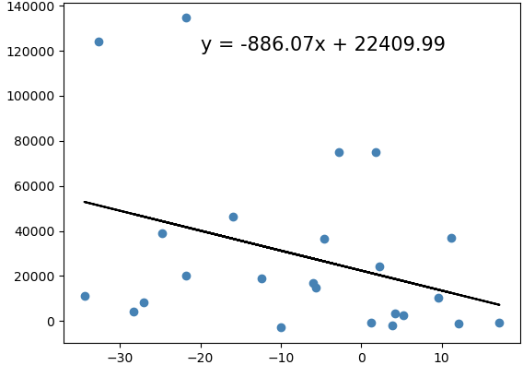
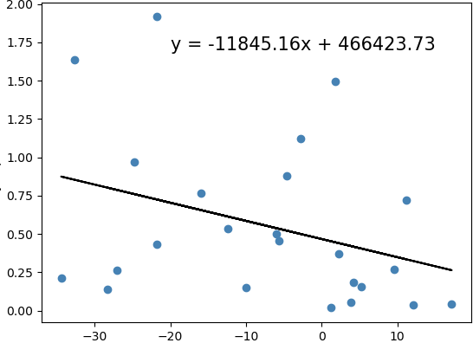
Low Access vs County Level Population
Change in Low Access vs Population Change
Change in Low Access vs Population
Population Change ‘10-’15
’15 County Population
Percentage Change in Low Access
Percentage Change in Low Access
Correlation coefficient = -0.36
P-value = 0.001
Correlation coefficient = -0.34
P-value = 0.001

Slide 17
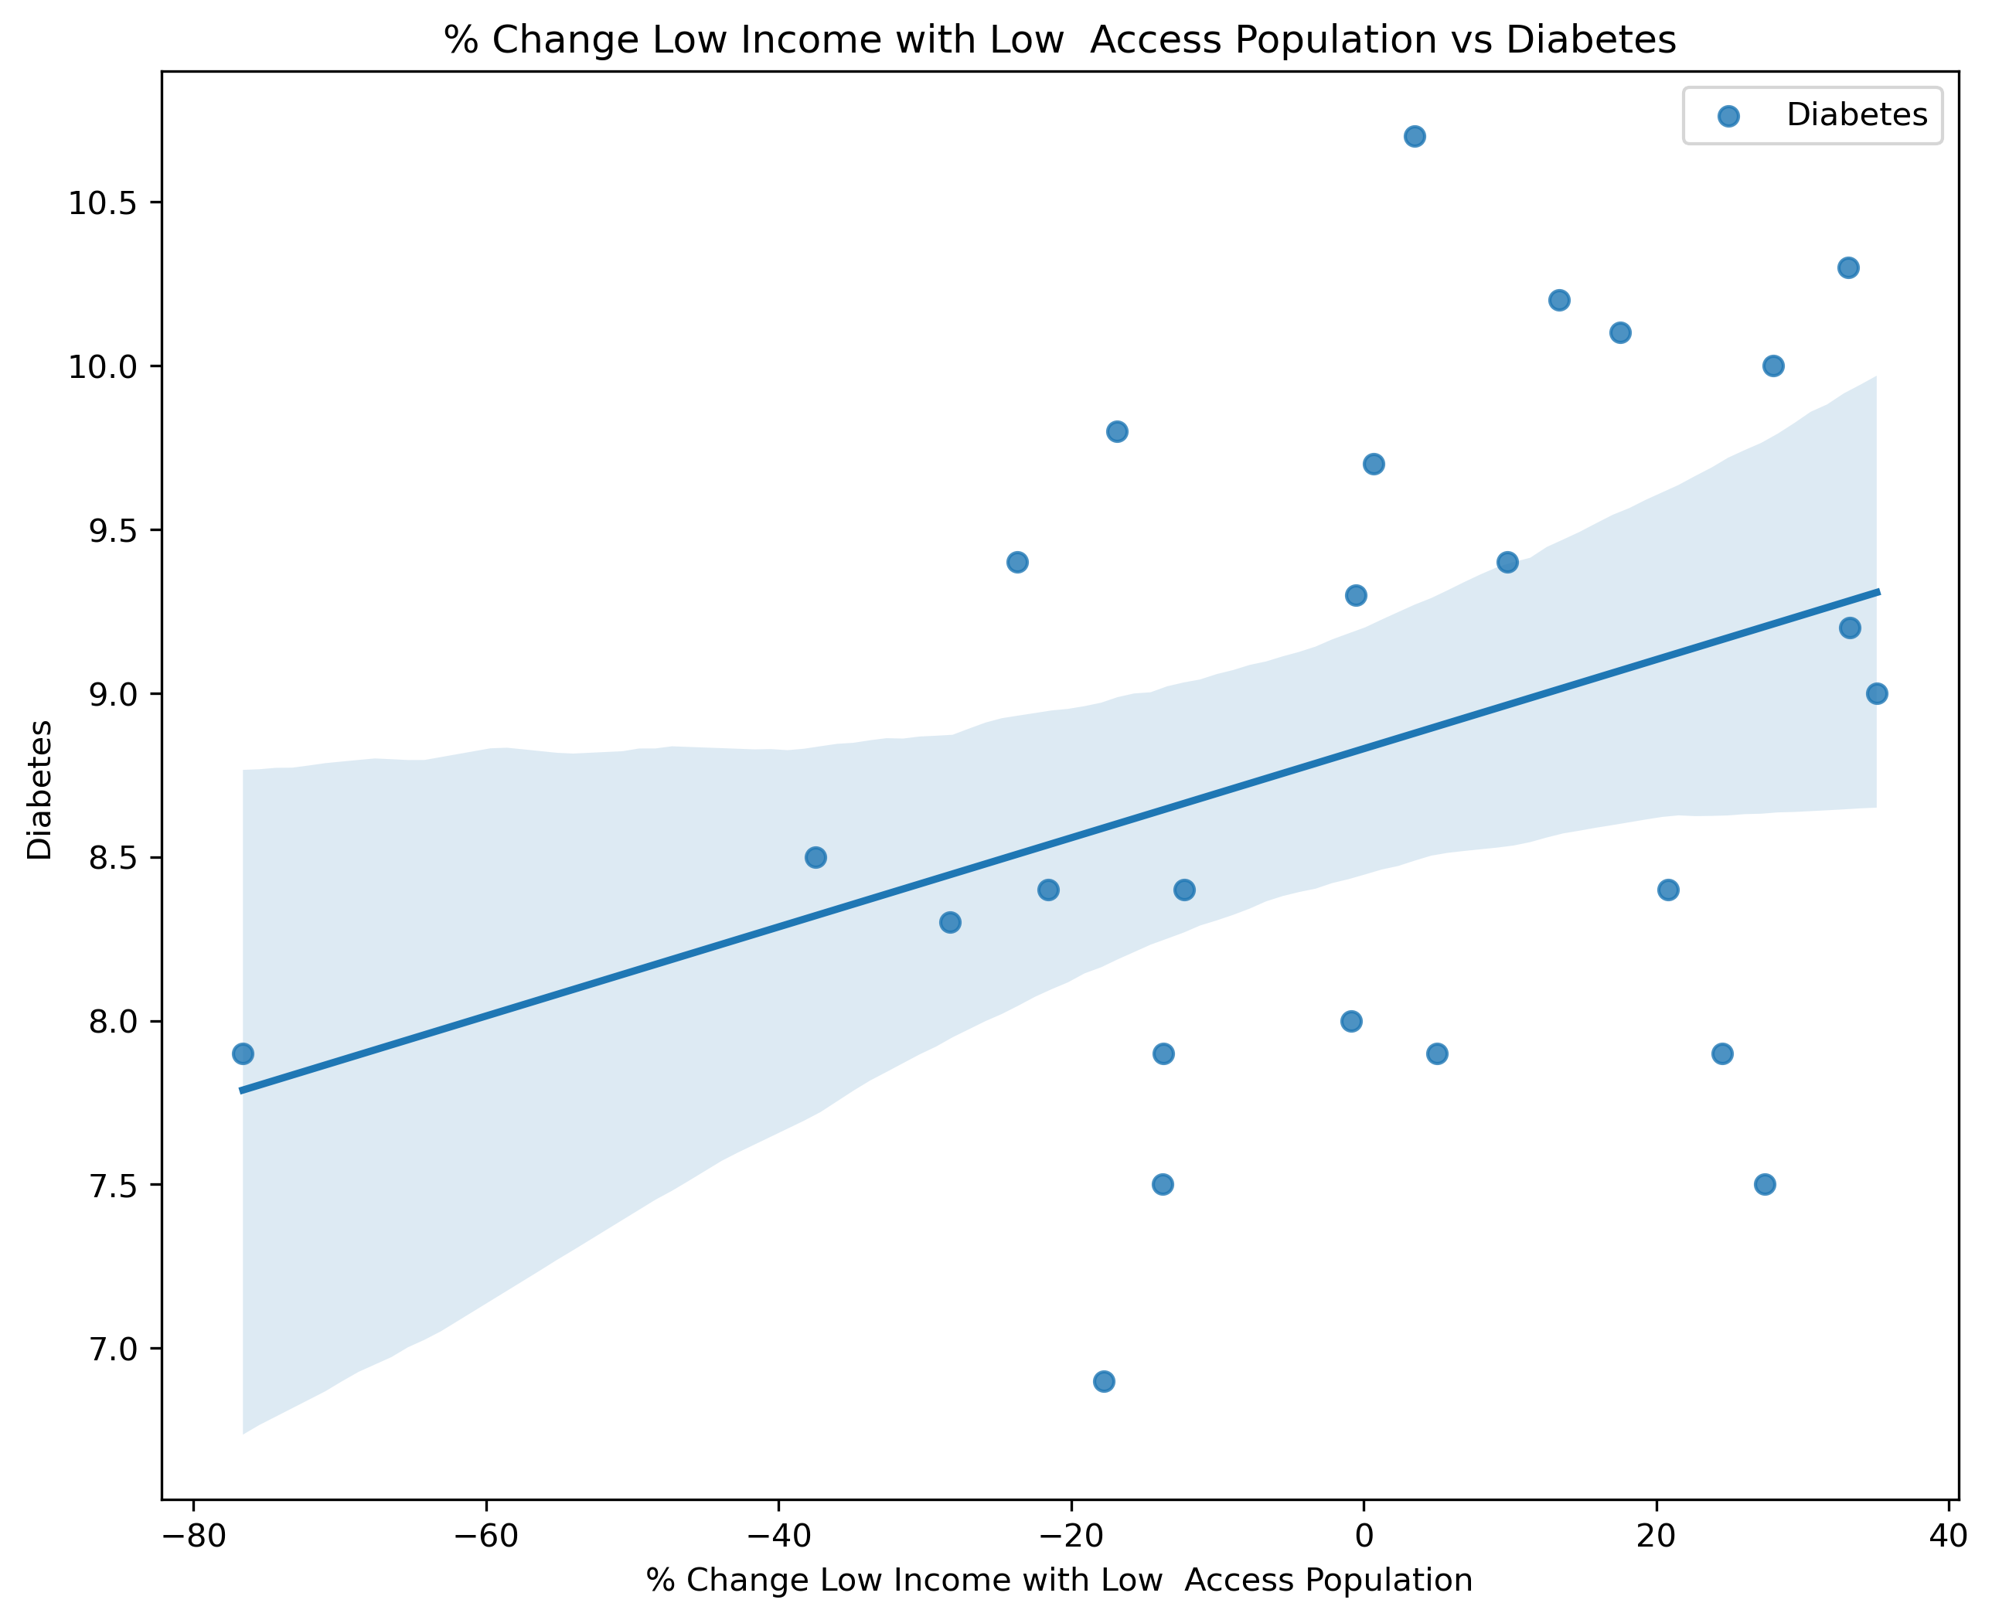
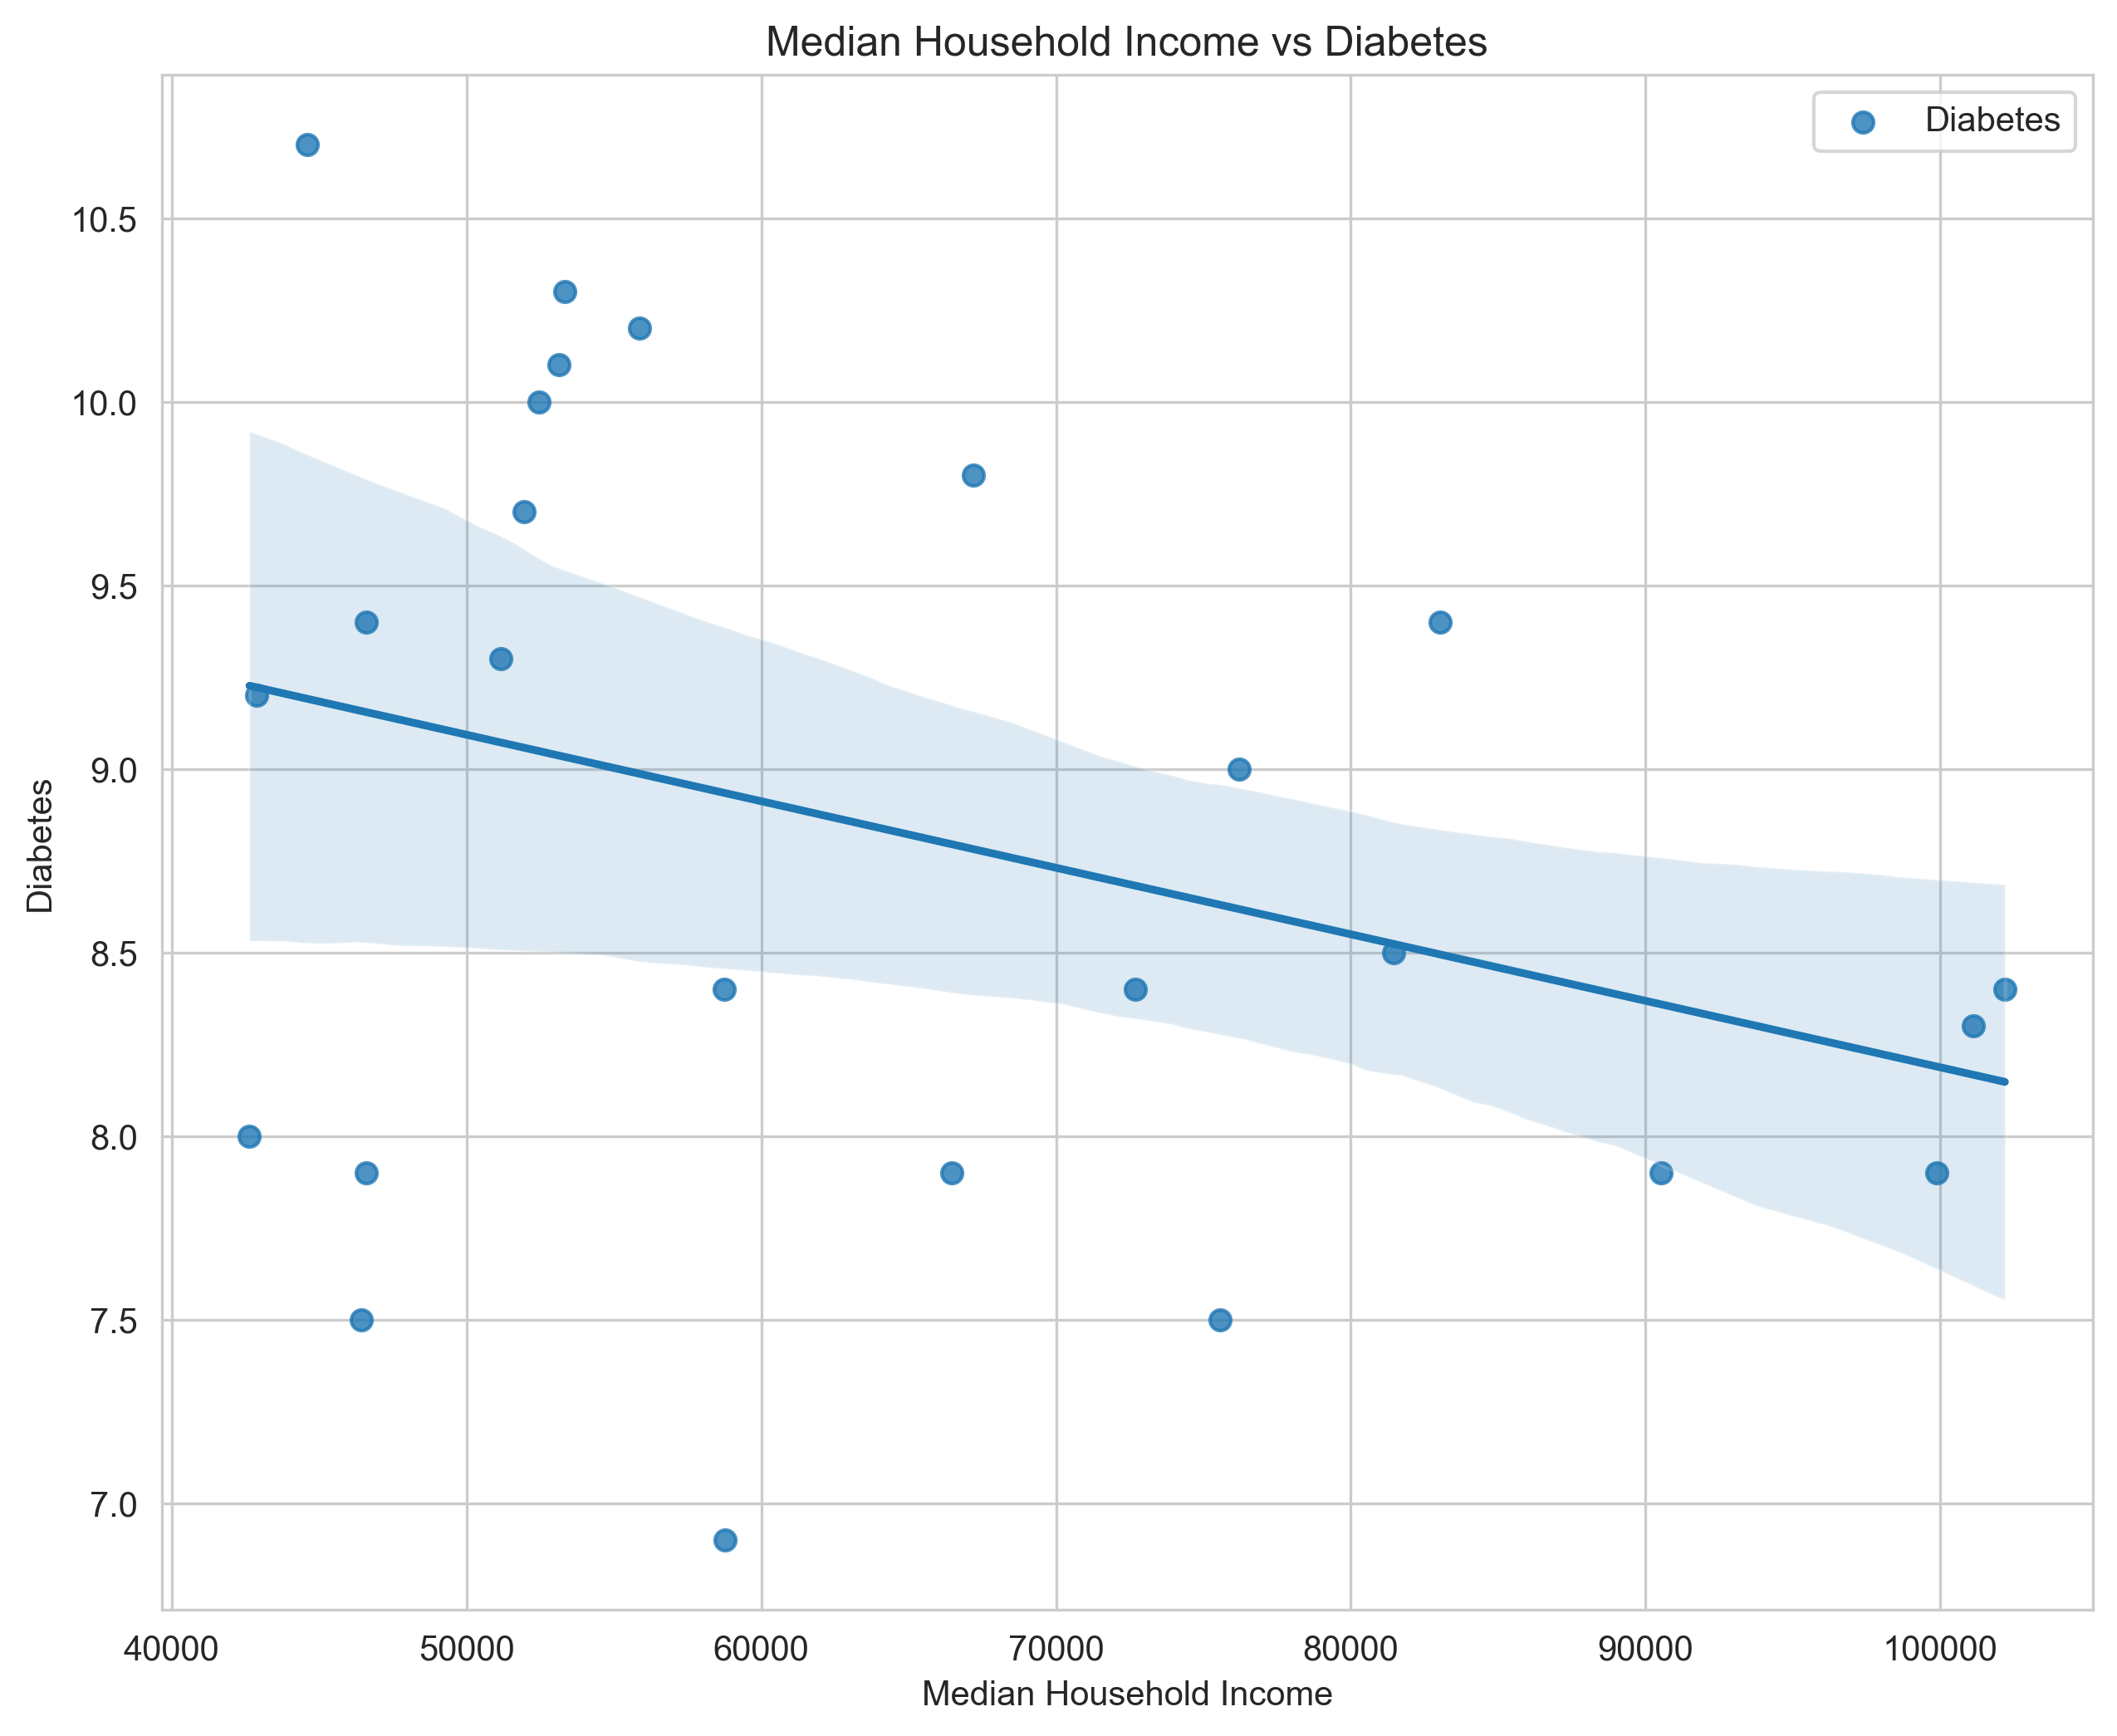
Diabetes
% Change Low Income Low Store Access vs Diabetes
Median Household Income vs Diabetes
Diabetes
Diabetes
% Change Low Income Store Access
Median Household Income
Correlation coefficient = 0.35
P-value = 0.008
Correlation coefficient = -0.34
P-value = 0.009

Slide 18
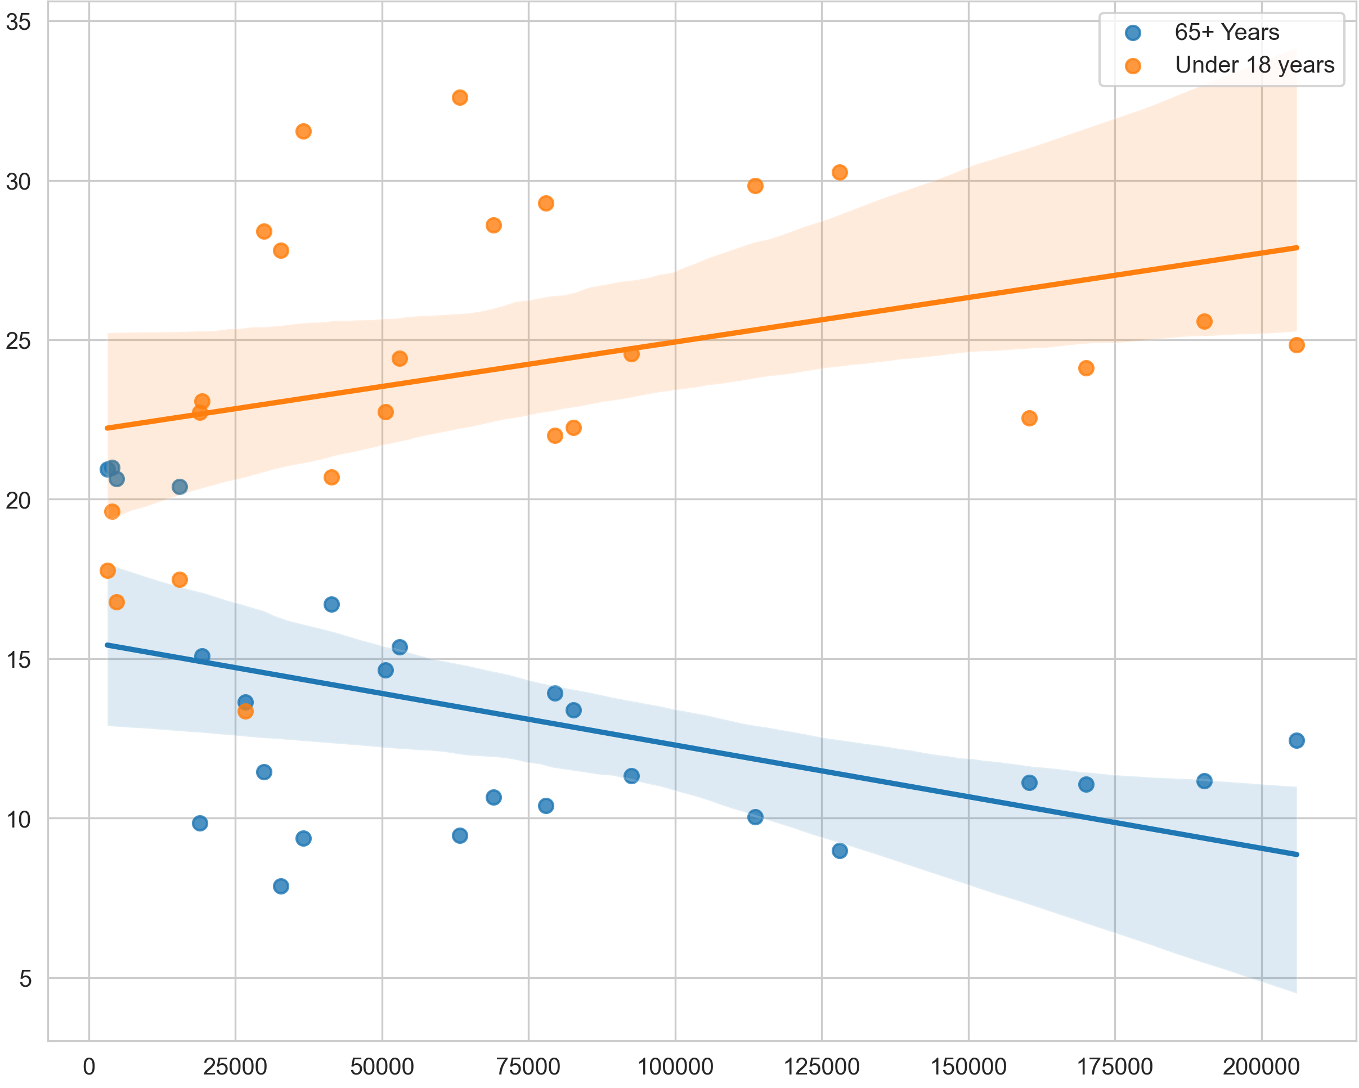
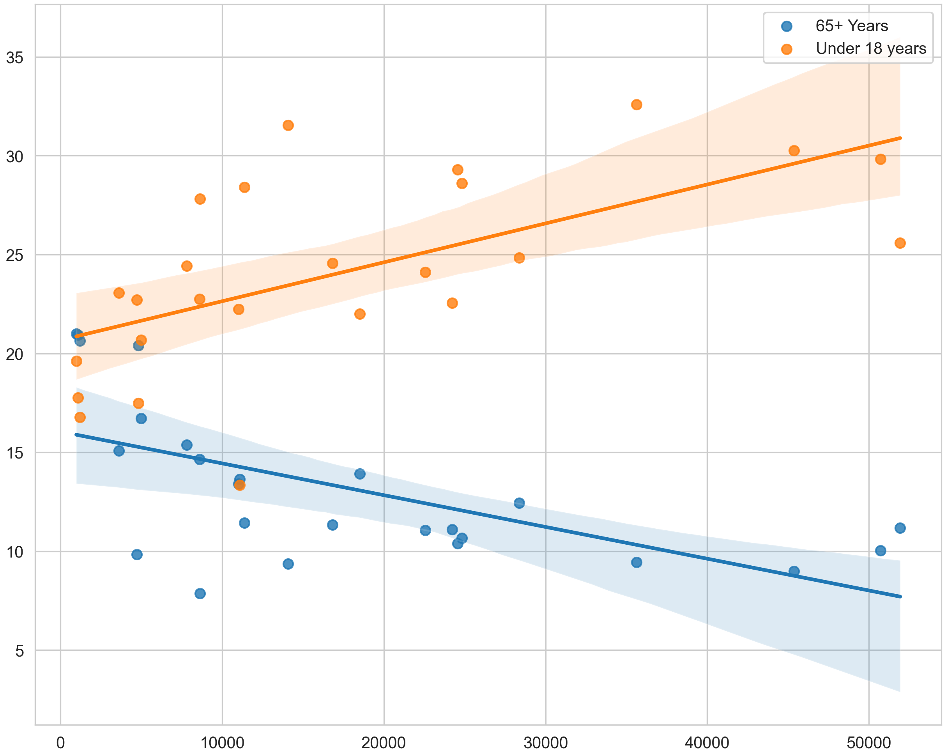
Access vs Age Group
Low Store Access vs Age Group
Low Income Low Store Access vs Age Group
Age Group
Age Group
Low Store Access
Low Income Low Store Access
65+ Correlation coefficient = -0.49
P-value = 0.001
65+ Correlation coefficient = -0.61
P-value = 0.001
18- Correlation coefficient = 0.34
P-value = 0.009
18- Correlation coefficient = 0.61
P-value = 0.001

Slide 19
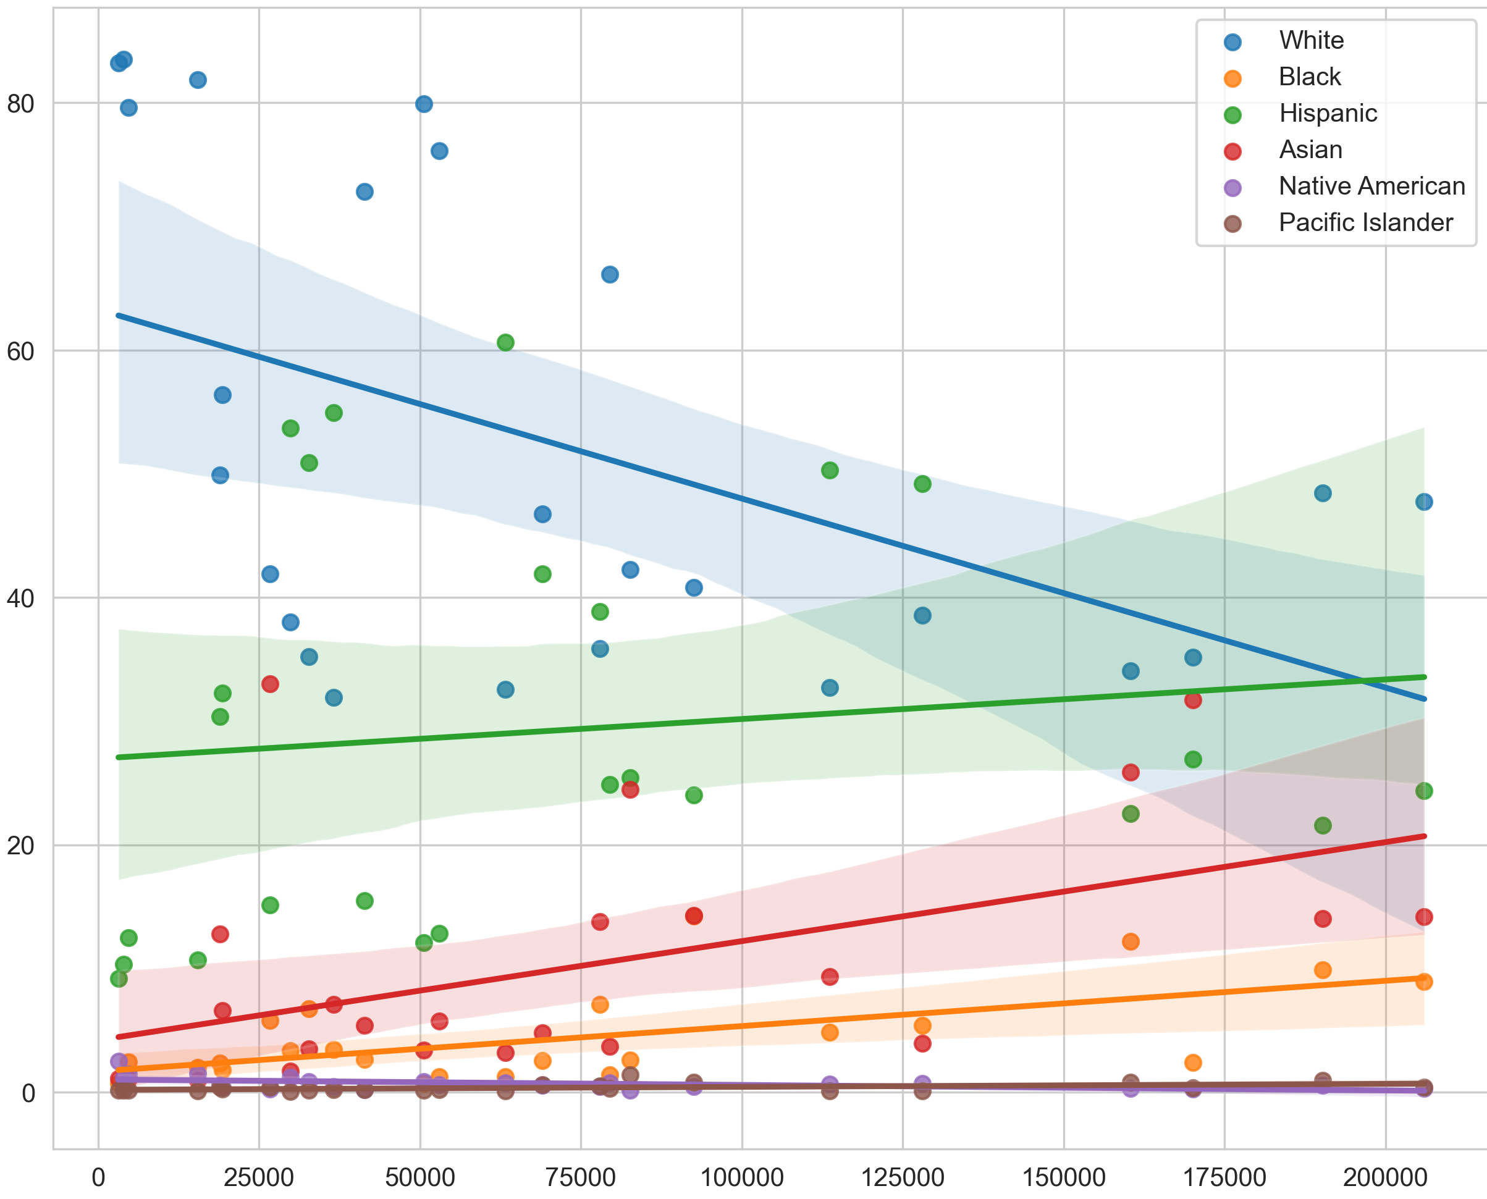
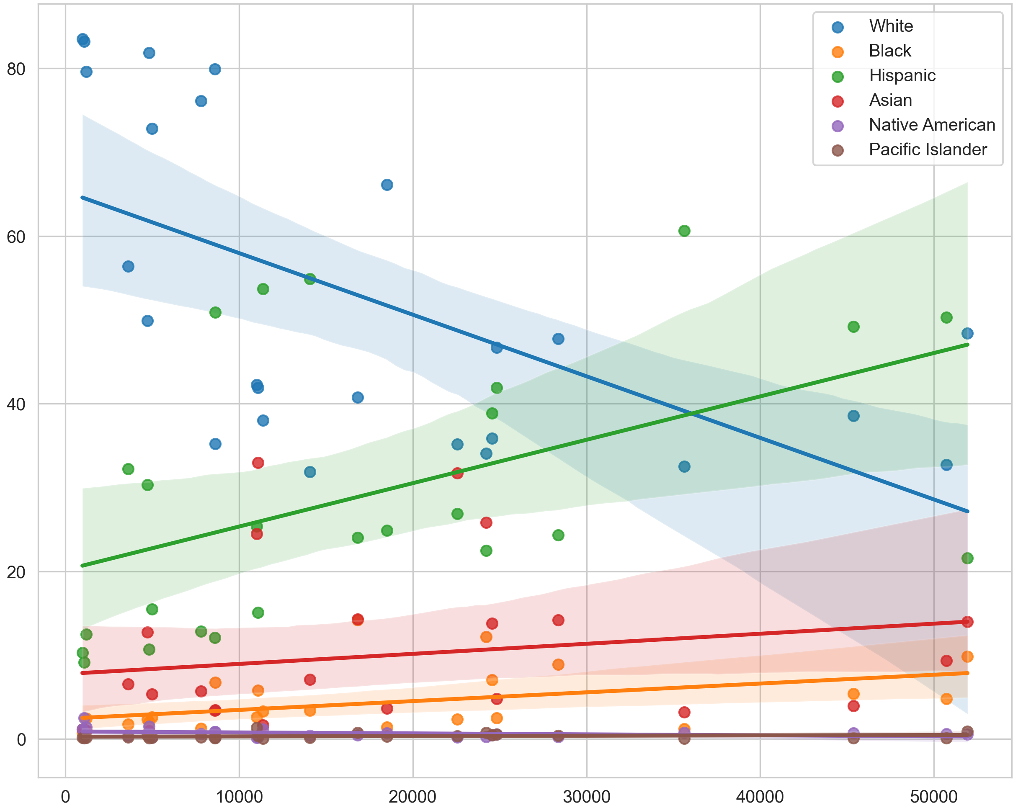
Access vs Race
Low Store Access vs Race
Low Income Low Store Access vs Race
Race
Race
Low Store Access
Low Income Low Store Access
Correlation
% White: -0.48
% Black: 0.59
% Hispanic: 0.12
% Asian: 0.50
% Native American: -0.5
% Pacific Islander: 0.45
Correlation
% White: -0.59
% Black: 0.43
% Hispanic: 0.48
% Asian: 0.19
% Native American: -0.33
% Pacific Islander: 0.20

Slide 20
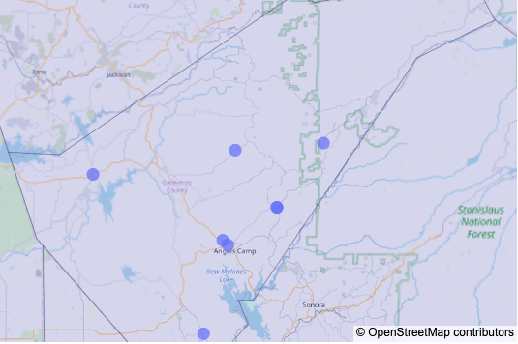
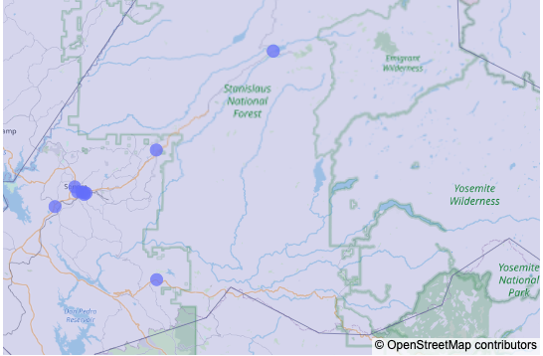
Tuolomne County, CA
County with least access overall
29.09% low access population
Calaveras County, CA
Greatest decline county
17.17% decline in access

Slide 21
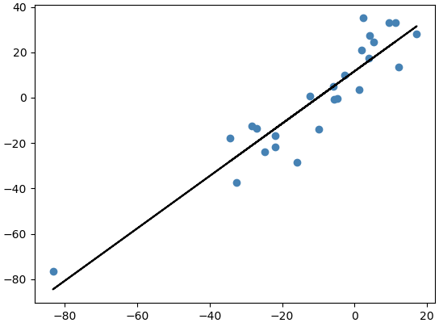
Conclusion
Change in Low Access vs Change in Low Income Low Access
Access to healthy food options increased in metropolitan areas and decreased in rural areas
All things being equal, income was the most determining factor on access to healthy food options
Demographics illustrates the same
Low Income Low Access
Low Access
Correlation coefficient = 0.93
P-value = 0.15
Strongest correlation

